Slide 1


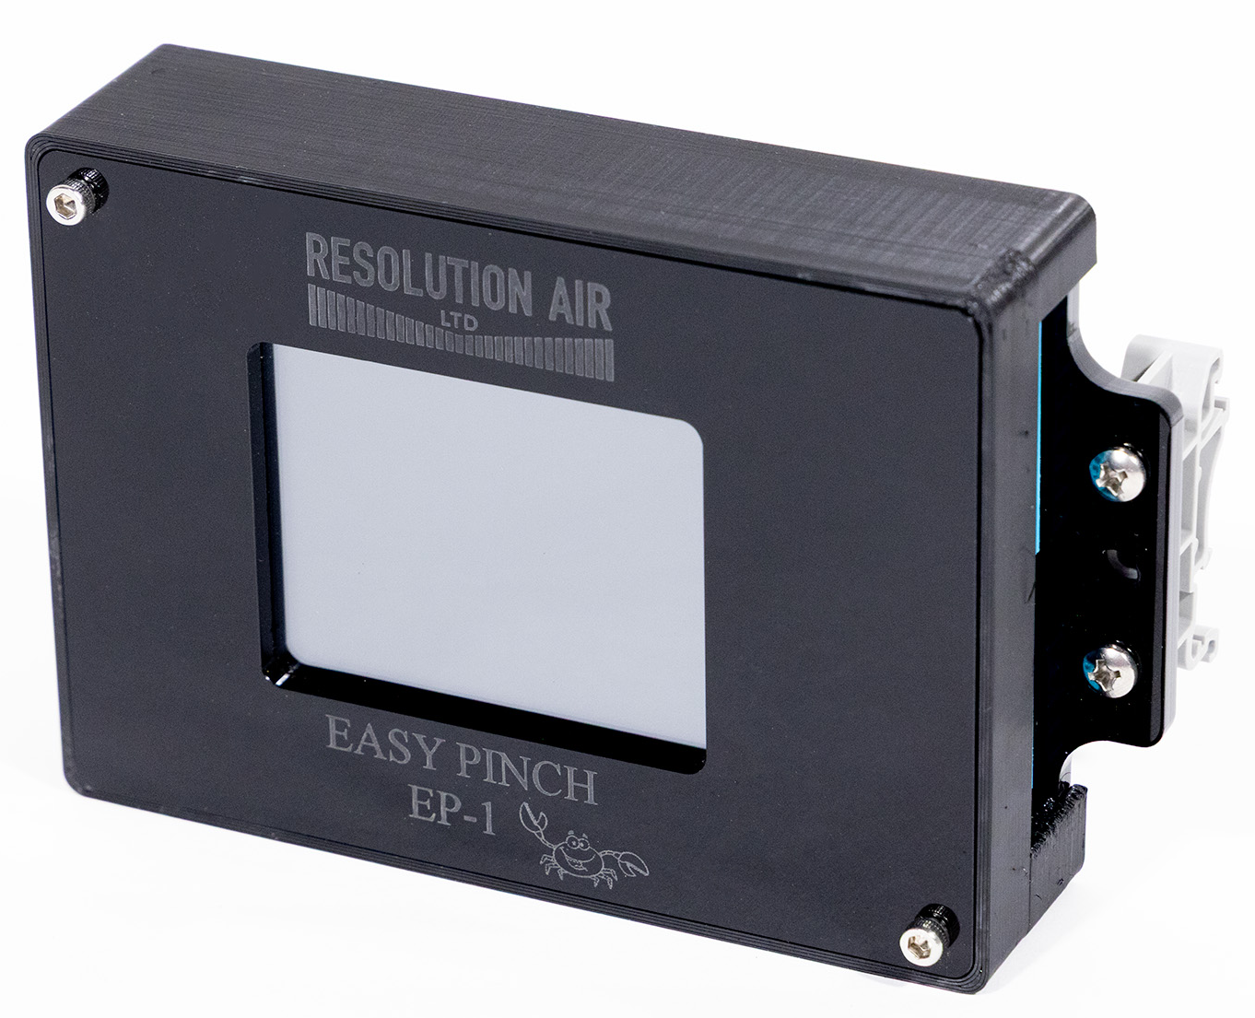
Technical Data Sheet
Easy Pinch Controller (EP-1)
Resolution Air, Ltd.’s Easy Pinch Controller (EP-1) is a compact motion control system combining a high performance stepper motor driver, intelligent controller with a full-color touch screen HMI. Purpose-built to optimize the performance of our patented Proportional Pinch Valves, the EP-1 enables fast deployment, simplified validation, and consistent performance. It’s dual mode design supports both 4-20 mA analog as well as digital on/off control. This all-in-one architecture simplifies system design, reduces wiring complexity, and improves reliability in automation environments. In addition, the EP-1 enables single-use system designers to simplify motion control, accelerate equipment deployment, and maintain consistent performance-while supporting the flexibility that disposable bioprocessing demands.
Common Applications
Automated machinery
System pressure control circuits
Process automation
Laboratory and test equipment
Common Single-Use (SU) Applications
Single-use pinch valve actuation
Media and buffer transfer skids
Single-use filtration systems
Chromatography and TFF modules
Bioreactor feed, bleed, and harvest systems
Pilot and clinical-scale production equipment
Key Features
Simplified control development and integration.
Complex stepper motor coding eliminated.
Input requirements: 4-20 mA analog , 5-24 VDC digital.
Reduced time and cost associated with developing control custom solution.
Dual Mode Functionality
Analog mode: 4-20 mA input signal controls valve position.
Digital mode: 5-24 VDC input signal provides On/Off functionality mimicking traditional pinch valve operation.
Combines driver, controller, and HMI into a single unit
Reduces panel space and overall system cost.
Compact footprint ideal for mobile carts and modular skids.
Din rail mounting brackets or back plate mountable.
Intuitive Color Touch Screen Interface
On screen configuration of performance parameters including:
Speed, acceleration, micro-stepping, idle current, analog and digital control.
No PLC required for set-up or adjustments.
Precise Motor Current Adjustment
Current settings are rotary switch selectable for both the MPPV and HPPV valve series
Enables quick tuning for different valves models or load conditions.
Electrical Parameters
Motor Type | Bi-Polar Chopper Motor (MPPV, HPPV valve series)
Control Inputs | Analog: 4-20 mA Analog Digital: 5-24 VDC, Optically Isolated
Motor Current | Rotary Switch Selectable 0-0.820 mA rms (maximum).
Display | Full Color Touch Screen (resistive touch)
Power Supply | +24 VDC supply
Analog Input Resolution | 16 Bit
1/26/2026
www.resolutionair.com Easy Pinch-1 (EP-1) Technical Data Sheet Tel. (513) 318-4600

Slide 2
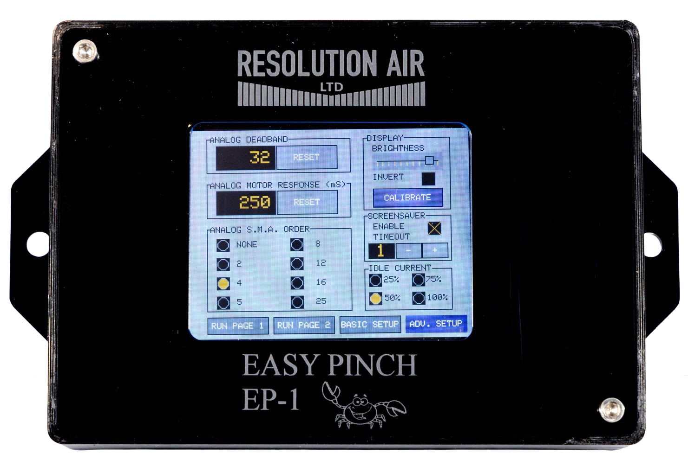
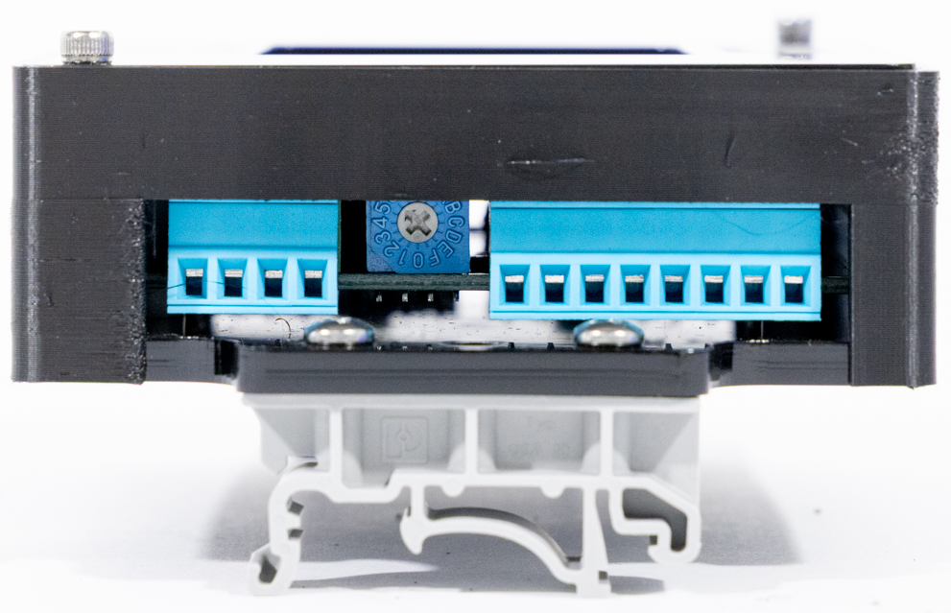
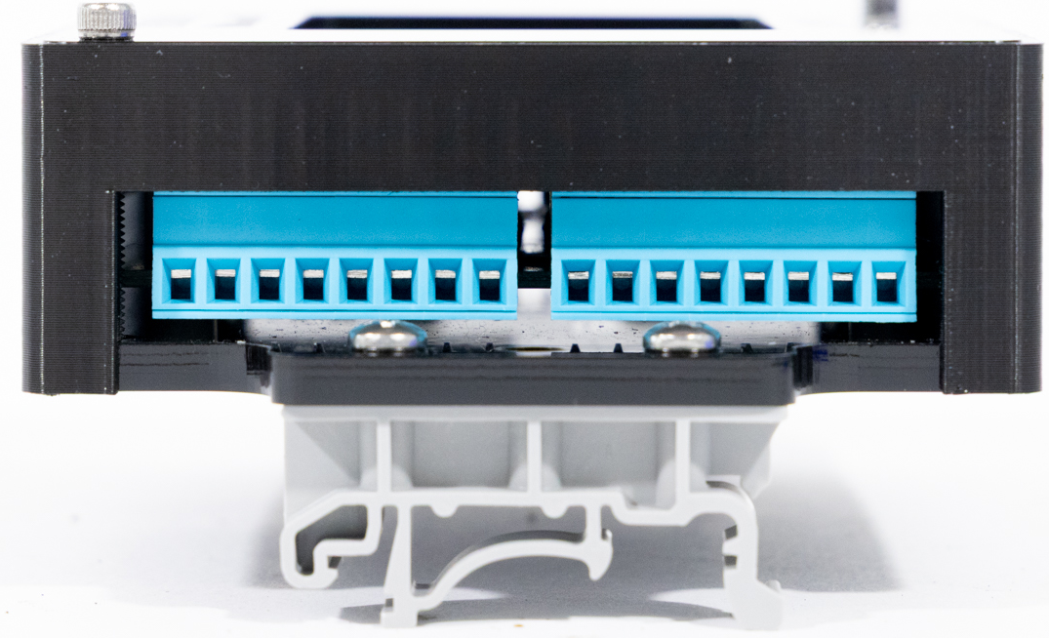
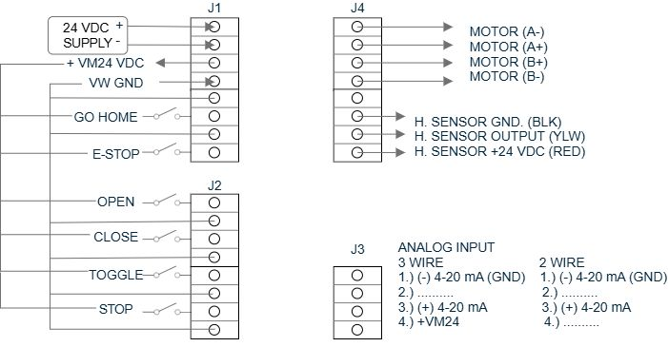
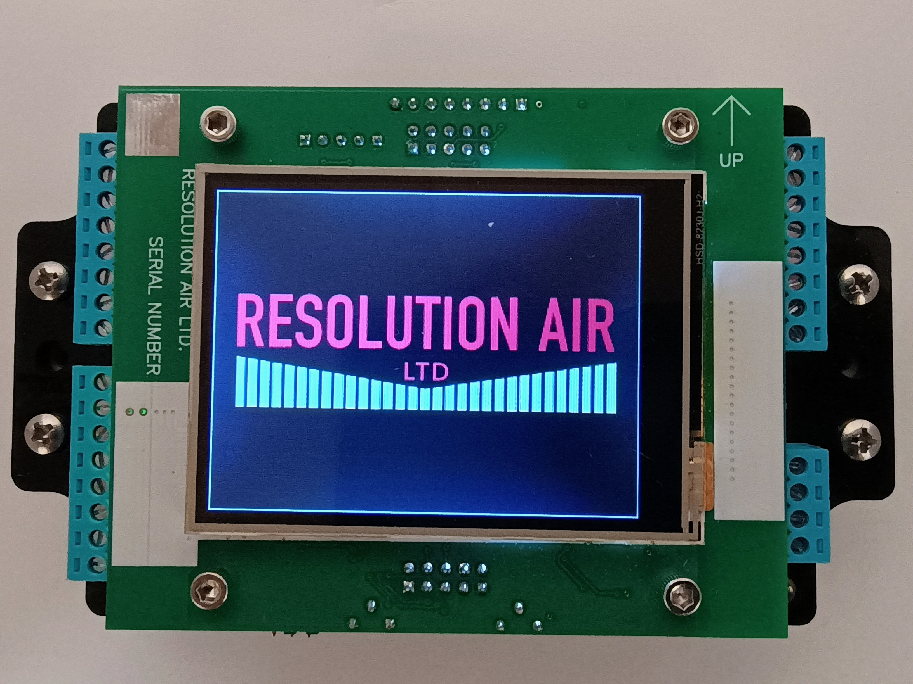
Technical Data Sheet
Easy Pinch Controller (EP-1)
1.175”
3.437”
1.900”
5.625”
HPPV-SERIES
MPPV-SERIES
www.resolutionair.com Easy Pinch-1 (EP-1) Technical Data Sheet Tel. (513) 318-4600

